Slide 1
Ayuda’s Project END (Eradicating Notario Deceit)
Ayuda
6925B Willow St. NW
Washington, DC 20012
Cori Alonso-Yoder, Staff Attorney
Tel: 202-243-7308
Fax: 202-387-0324
Email: cori@ayuda.com
Notes:
Introduce Project END at Ayuda
Launching in May 2013
w/ generous support from the D.C. Bar Foundation
Community service providers and community activists - represent important points of contact for victims.
Referrals to Project END

Slide 2
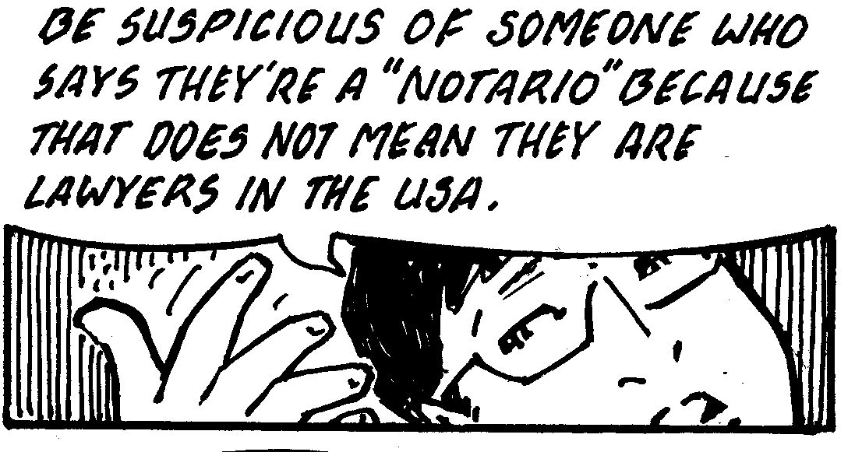
What Notario means in other places around the world.
Lo que significa Notario en otras partes del mundo.
Notes:
As per the comic, notario can mean lawyer in many other parts of the world!
In Mexico, a notario public must have served as an attorney for at least five years, be above the age of 30, with no criminal convictions, and s/he must have passed a rigorous exam.
In Washington, D.C., a notary must just be above the age of 18, be of good moral character, live or work in the D.C., complete an application, pay the $75 application fee, submit a surety bond, and go through a mandatory orientation.
Culturally, there can be confusion over what services a notario can provide.

Slide 3
Advertisements & Signs for
Notario Services in Central America
Notes:
Pictures from El Salvador, Nicaragua, and Mexico

Slide 4
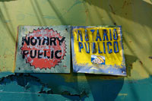
In the U.S., a notario is not a reputable individual, lawyer, law student, or accredited representative, and therefore cannot practice immigration law before the immigration courts, USCIS, or the BIA.
A notario can provide translation services and notarize documents.
En los Estados Unidos, un notario no es una persona acreditada, ni un abogado, estudiante de derecho, o representante acreditado, y por lo tanto, no puede practicar la ley de inmigración ante los tribunales de inmigración, USCIS, o BIA.
Un notario le puede ofrecer servicios de traducción y le puede autenticar documentos.
Notes:
Federal immigration law
8 C.F.R. § 292.1(a)(3) Representation of others.
To qualify as a reputable individual, an individual must meet all of the following criteria:
be a person of good moral character
appear on an individual basis, at the request of the alien
receive no direct or indirect remuneration for his or her assistance
file a declaration that he or she is not being remunerated for his or her assistance
have a preexisting relationship with the alien (e.g., relative, neighbor, clergy), except in those situations where representation would otherwise not be available, and
be officially recognized by the Immigration Court

Slide 5
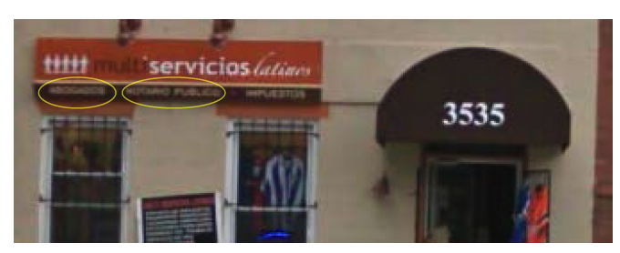
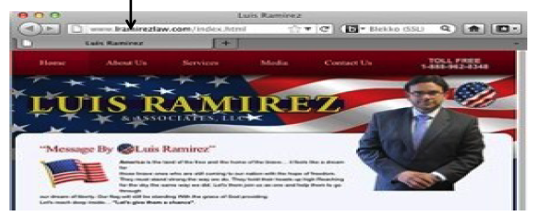
Advertisements & Signs for
Notario Services in D.C.,
Virginia & Maryland
D.C. - Hernandez v. Flores, et al. (D.C. Super. Ct.)
Virginia - Flores v. Ramirez
(Fairfax Co. Cir. Ct.)
Maryland - Argueta v. Mejia
(Md. Cir. Ct.)
Notes:
D.C. storefront
Virginia web advertisement (also had a radio program)
We will revisit the Ramirez case in a later slide.
Maryland print advertisement

Slide 6
Based on our surveys, unauthorized legal representatives may also use any of the following terms, or others.
Assistants (Asistentes)
Court licensed (Licenciado de la corte)
Helpers (Ayudantes)
Lawyers (Abogados)
Consultants (Consultores)
Immigration service officers (Oficiales de inmigración)
Paralegals (Para legales)

Slide 7
Possible Harms:
Loss of money
Loss of employment opportunities
Loss of important, personal documents
Damage to legal case
Severe immigration consequences
Impact on family relations
Los Posibles Daños:
La pérdida de dinero
La pérdida de oportunidades de empleo
La pérdida de documentos personales y importantes
Daño al caso legal
Consecuencias graves de inmigración
Impacta a relaciones entre la familia

Slide 8
Loss of money/La pérdida de dinero
Charge by Notario for his/her legal services:
$ can be thousands of dollars
Examples of USCIS Costs (just for the application):
Application for Employment Authorization $380
Petition for Immigrant Relative $420
DACA $465
Application for Naturalization w/ biometrics $680
Application to Register Permanent Residence or Adjust Status $1,070
Minimum Wage in Washington, D.C.:
$8.25/hour x 40 hrs. = $330 for a 40 hr. week
Notes:
What this monetary damage can mean for a victim

Slide 9
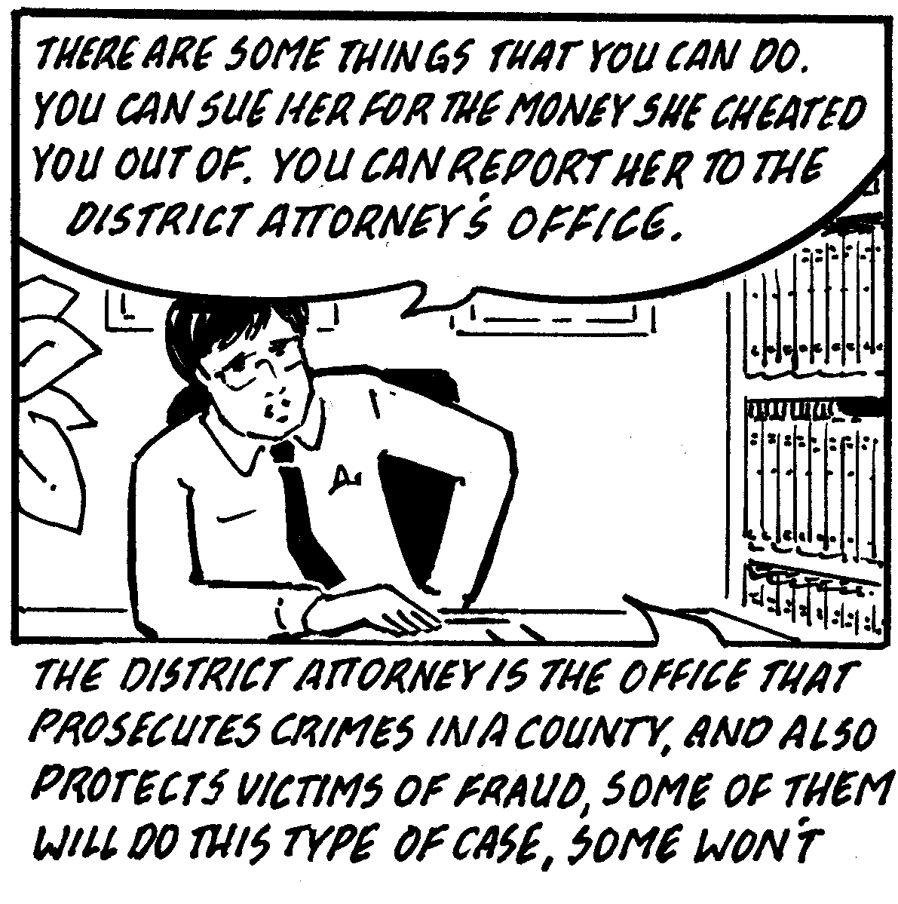
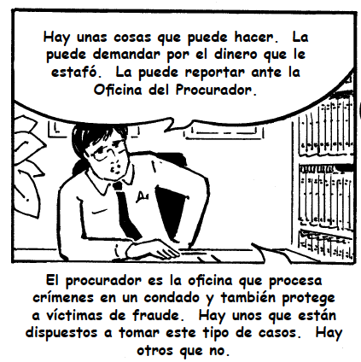
What can we do?/¿Qué podemos hacer?
Legal Remedies:
Criminal: prosecution of notario, potential monetary compensation
Civil: injunction, monetary damages
Immigration: U Visa (if additional qualifying crime), Prosecutorial Discretion, Ineffective Assistance of Counsel
Remedios Legales:
Criminal: enjuiciamiento del notario, la posibilidad de compensación monetaria
Civil: una medida cautelar, daños monetarios
Inmigración: la Visa U (si hay un crimen de calificación adicional), la discreción procesal, la asistencia ineficaz
Notes:
Criminal
theft, fraud, and extortion
As a matter of public safety, D.C. Metropolitan Police Department (MPD) does not inquire into immigration status or share information about victims’ status.
United States Attorney’s Office for the District of Columbia (USAO) also does not inquire into immigration status.
Civil
Legal Theories:
State’s consumer protection statute
Negligent Misrepresentation
Common law fraud
Breach of K
UPL
Notario specific statute in MD (MICA)
Immigration
Very new idea!
Really fact dependent
for U visa – need a qualifying crime! (like extortion, blackmail, obstruction of justice, witness tampering, perjury, fraud in foreign labor contracting, stalking)
Mention the elements for a U visa
Can also mention Motion to reopen where a deportation order has been entered (by Judge) AND Motion to subpeona the notario (by Judge)
For our reference (in case it comes up in the Q&A)
Unauthorized Practice of Law, Rule 49 of the Rules of the District of Columbia Court of Appeals:
(a)General Rule. No person shall engage in the practice of law in the District of Columbia or in any manner hold out as authorized or competent to practice law in the District of Columbia unless enrolled as an active member of the District of Columbia Bar, except as otherwise permitted by these Rules.
(2) “Practice of Law” means the provision of professional legal advice or services where there
is a client relationship of trust or reliance. One is presumed to be practicing law when engaging in any
of the following conduct on behalf of another:
(A) Preparing any legal document, including any deeds, mortgages, assignments, discharges,
leases, trust instruments or any other instruments intended to affect interests in real or personal
property, will, codicils, instruments intended to affect the disposition of property of decedents’ estates,
other instruments intended to affect or secure legal rights, and contracts except routine agreements
incidental to a regular course of business;
(B) Preparing or expressing legal opinions;
(C) Appearing or acting as an attorney in any tribunal;
(D) Preparing any claims, demands or pleadings of any kind, or any written documents
containing legal argument or interpretation of law, for filing in any court, administrative agency or
other tribunal;
(E) Providing advice or counsel as to how any of the activities described in subparagraph (A)
through (D) might be done, or whether they were done, in accordance with applicable law;
(F) Furnishing an attorney or attorneys, or other persons, to render the services described in
subparagraphs (a) through (e) above.
(2) Violations of the provisions of this Rule 49 shall be punishable by the Court of Appeals as contempt and/or subject to injunctive relief. The Court of Appeals holds the power to include within its remedy compensation to persons harmed by violation of this Rule or of an injunction entered under it.
D.C. Consumer Protection Procedures Act
Chapter 39 D.C. Code § 28-3904 Unlawful trade practices
Prohibits:
• “Represent[ing] that ... services have a source, sponsorship, approval, certification ... characteristics ...uses, benefits ... that they do not have.”
• “Represent[ing] that the person has a sponsorship, approval, status, affiliation, certification, or connection that the person does not have.”
• “Misrepresent[ing] as to a material fact which has a tendency to mislead.”
• “Fail[ing] to state a material fact if such failure tends to mislead.”

Slide 10
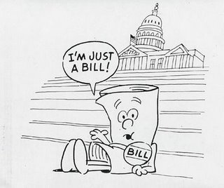
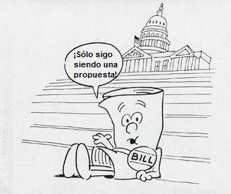
Immigration Reform
Do not be a victim of fraud by notaries and/or unscrupulous lawyers!
“Confusion is a crook’s best friend.”
- James Quiggle
La Reforma Migratoria
¡No sea victima de fraude por parte de notarios y/o abogados inescrupulosos!
"La confusión es el mejor amigo de un ladrón.” - James Quiggle
Notes:
Bill has not passed until you see President Obama signing it. ☺

Slide 11
Community education
Refer violations and assist victims with consumer complaints
Assist victims in interviews with law enforcement
Bring civil suits for damages
Provide legal representation to notario fraud victims in immigration proceedings
Educación comunitaria
Referir violaciónes de la ley y asistir a las víctimas a hacer quejas de consumo
Ayudar a las víctimas en las entrevistas con la policía
Traer demandas civiles por daños
Proporcionar representación legal a las víctimas de fraude de un notario en los procedimientos de inmigración
Ayuda’s Project END (Eradicating Notario Deceit)
Notes:
LEP, Low-income immigrants are particularly targeted by this type of fraud
Ayuda – unique position to address this problem; Ayuda started as a consumer protection non-profit

Slide 12
Ayuda’s Project END (Eradicating Notario Deceit)
Ayuda
6925B Willow St. NW
Washington, DC 20012
Cori Alonso-Yoder, Staff Attorney
Tel: 202-243-7308
Fax: 202-387-0324
Email: cori@ayuda.com

