Slide 1
Federal Trade Commission Webinar
Fighting Consumer Fraud &
Identity Theft in Kansas
September 21, 2023

Slide 2
Welcome!
Presenters:
Joannie Wei, FTC, Midwest Regional Office
Fran Oleen, Office of Kansas Attorney General Kris Kobach
Jon Fleenor, U.S. Attorney’s Office – District of Kansas
Matt Keenan, Kansas Legal Services
Josh Planos, Better Business Bureau of Kansas
Mary Tritsch, AARP Kansas
Cristina Miranda, FTC, Division of Consumer and Business Education
Andrew Rayo, FTC, Division of Consumer and Business Education

Slide 3
Overview
The Kansas landscape
The latest scams
Identity theft
Working together to fight fraud and identity theft

Slide 4
National Data

Slide 5
National Data

Slide 6
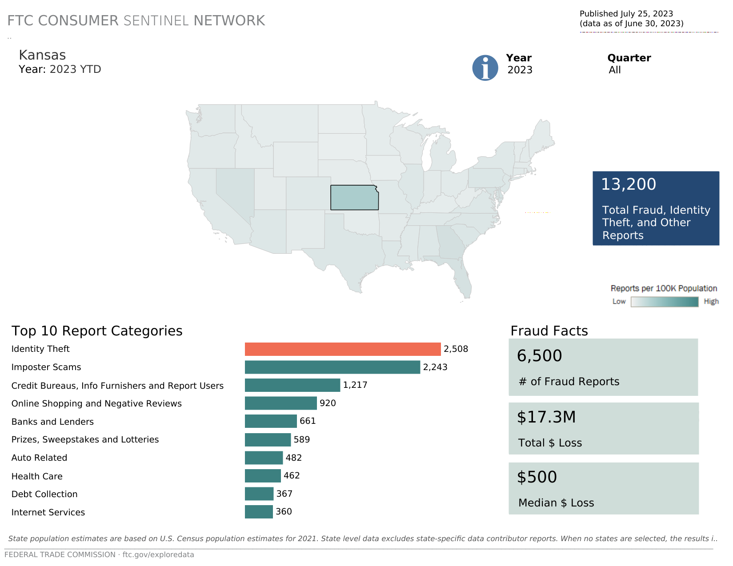

Slide 7
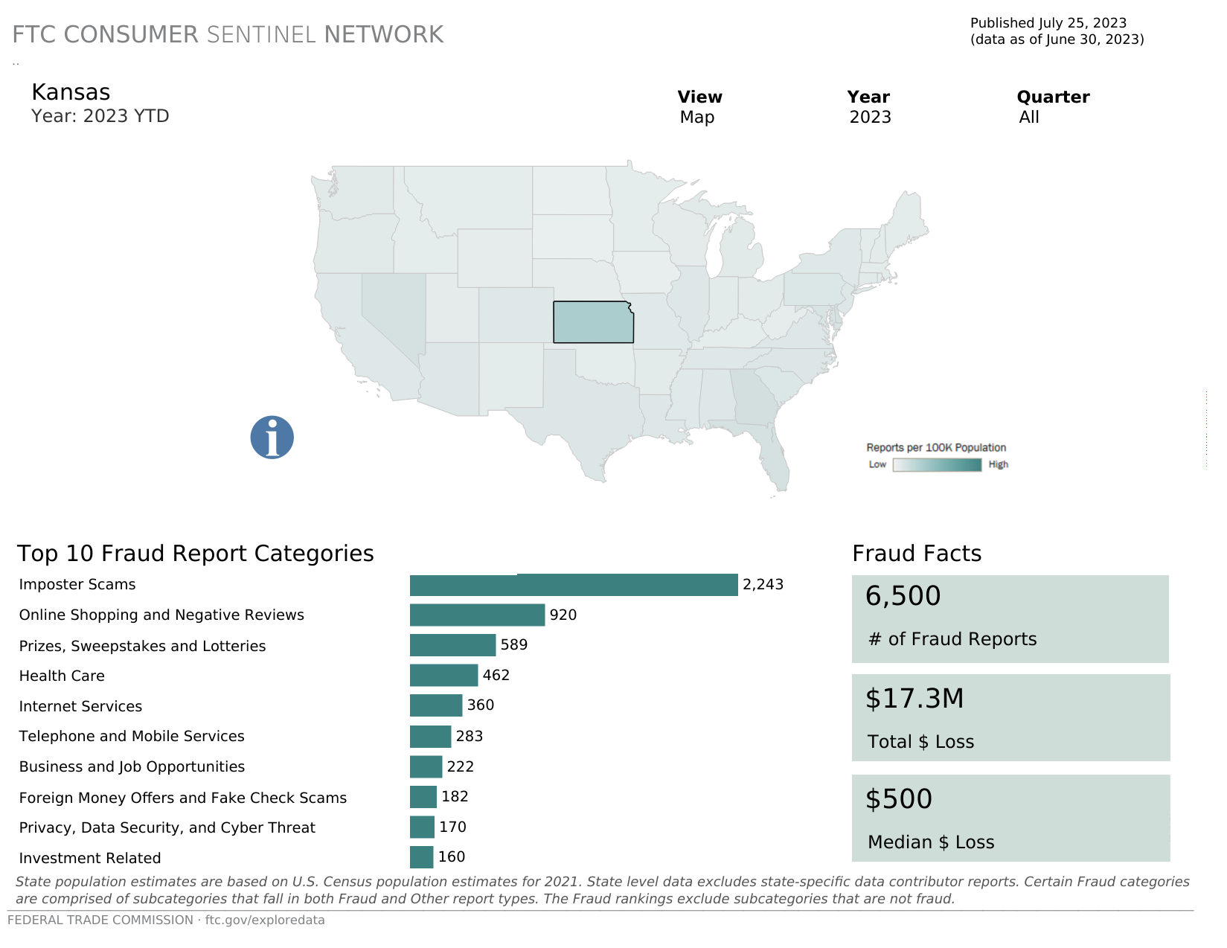

Slide 8
THE LATEST SCAMS

Slide 9
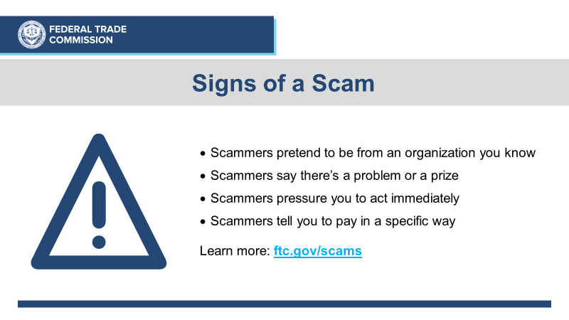

Slide 10
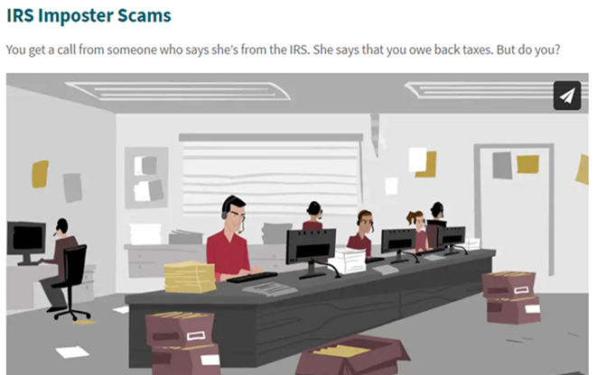
Government Impersonator Scams

Slide 11
Government Impersonator Scams
Government agencies don’t call people out of the blue with threats or promises of money
Do not trust caller ID
Check with the real agency
Only scammers demand payment by gift card, wire transfer, cryptocurrency, or payment app
ftc.gov/imposters

Slide 12
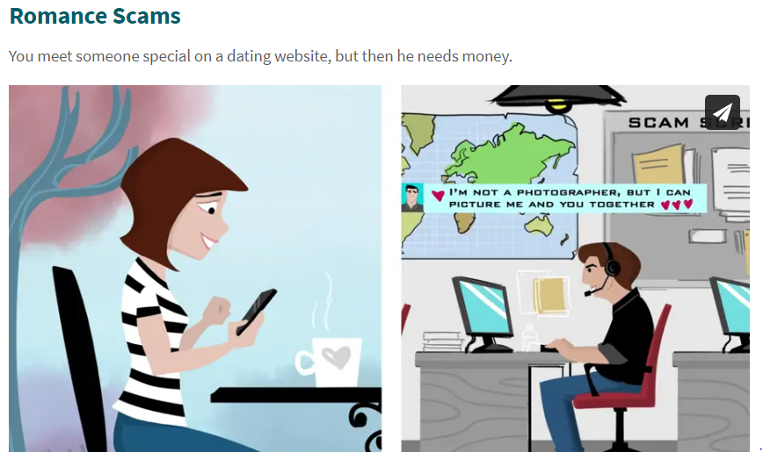
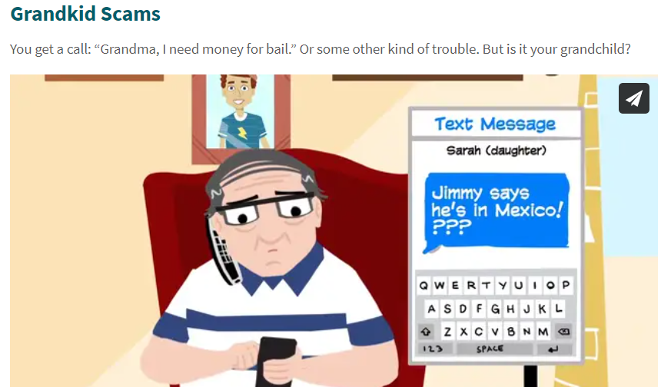
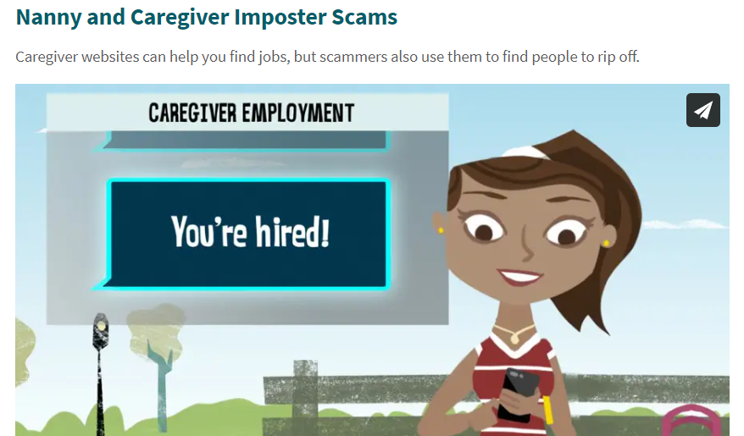
ftc.gov/imposters

Slide 13
Business Impersonator Scams
If you got an unexpected call, text, message:
Don’t call a phone number they gave you.
Don’t click on any links.
Don’t give remote computer access.
REMEMBER: Only scammers demand payment by gift card, wire transfer, cryptocurrency or a payment app.

Slide 15
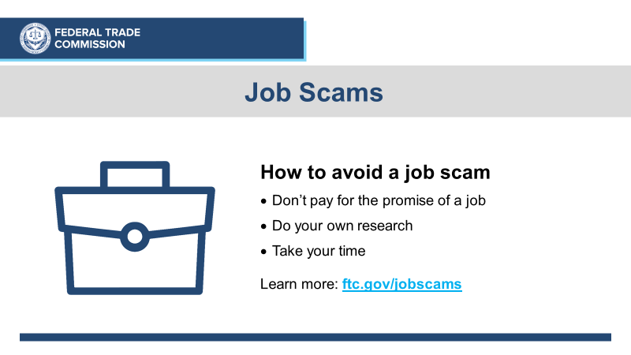

Slide 17
Someone uses your personal information to:
Open accounts
File taxes
Buy things

Slide 18
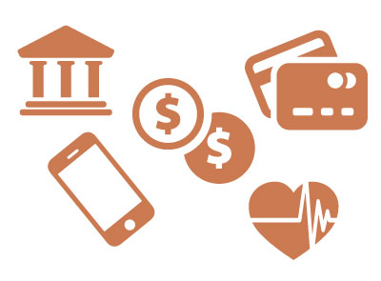
Examples of Misuse
Impact
Open Credit Cards
Open Utility Accounts
Apply for a Tax Refund
Get a Loan
Apply for Employment
Get Medical Care
Denial of credit/loans
Denial of public benefits
Denial of medical care
Denial/loss of employment
Harassment by debt collectors
Legal issues/arrest
Stress/anxiety
Recovery time/expense

Slide 19
Reduce the Risk
Review mail, especially financial statements
Check credit report every year:
Free report from AnnualCreditReport.com
Protect Social Security and Medicare numbers
Store documents securely and shred before discarding
File taxes early
Notes:
.]

Slide 20
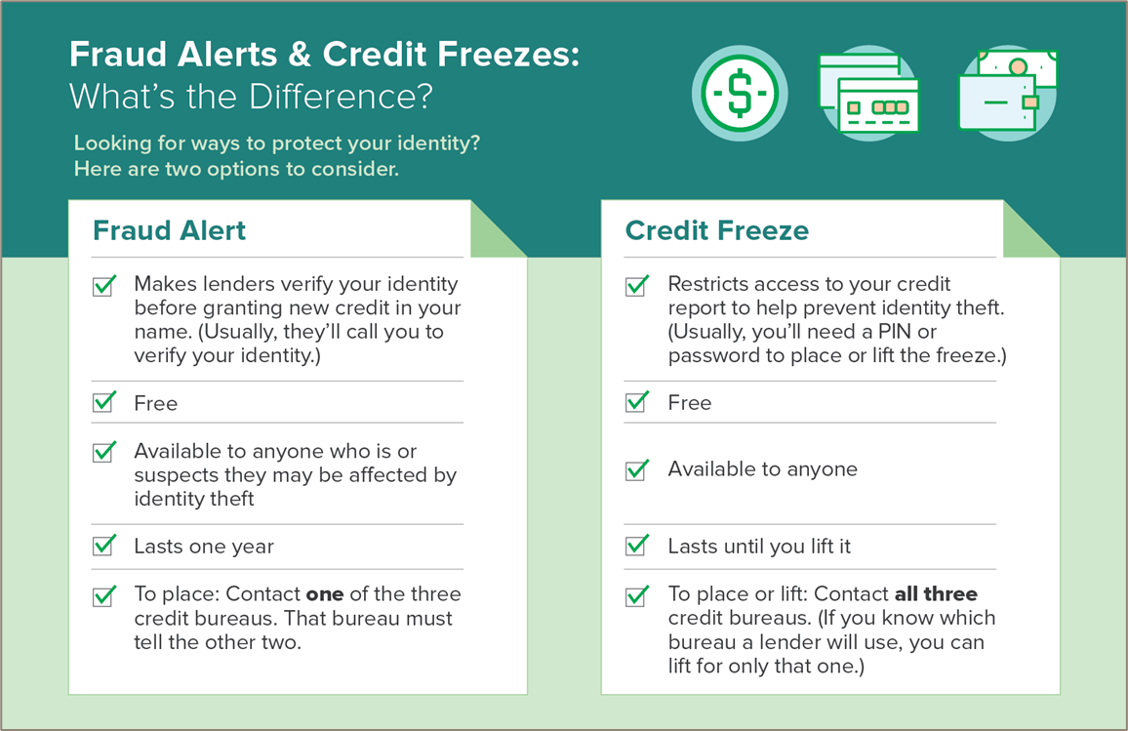

Slide 21
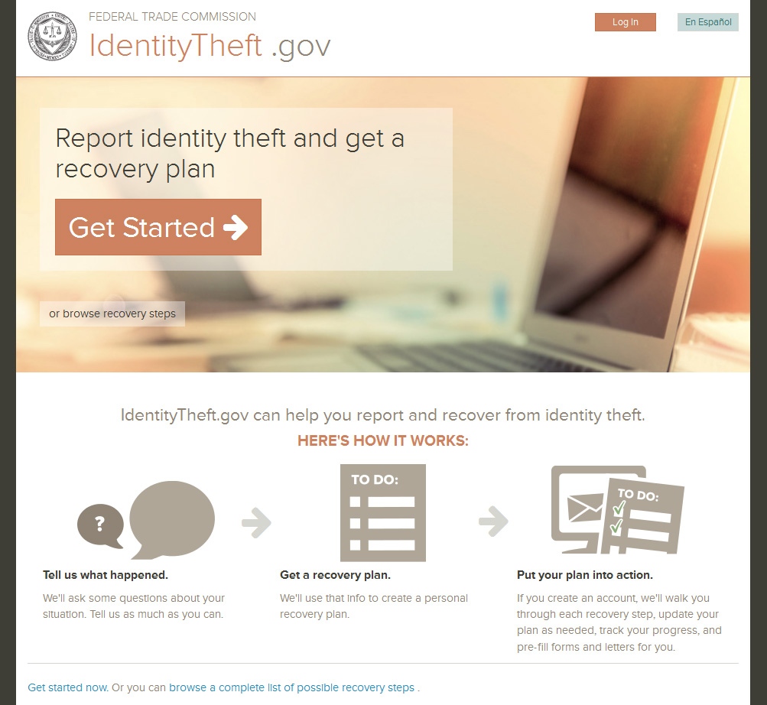

Slide 22
Kris W. Kobach Kansas Attorney General Public Protection Division
What we do:
Protect Kansas consumers from unlawful, deceptive and unfair practices in the marketplace through education, community outreach, and enforcement of consumer protection laws.
How we do it:
Investigate, mediate, and bring legal actions to stop unlawful practices
Investigate consumer complaints and process inquiries
Provide restitution to victims, deter and discourage unfair business practices
Educate consumers through live speaking engagements, information fairs, websites, collateral materials, and answers to phone and email inquiries
Encourage suppliers to follow Kansas law through personal contact and speaking engagements
Enforce Kansas Consumer Protection Act and other consumer protection laws

Slide 23
Top Complaint Categories 2022
 | Complaint Category
1 | Internet Scam
2 | General Services
3 | Used Car Sales Practices
4 | Identity Theft
5 | Auto Repair & Service Problems
6 | Warranty Problems (other than automobiles)
7 | Internet Sales
8 | General Home Improvement
9 | Telephone Services
10 | Health Service Providers – including medical professionals, hospitals, etc.
The Kansas Attorney General’s Consumer Protection unit responded to more than 3,500 investigative requests in 2022.

Slide 24
Contact Us
Phone: (785) 296-3751
Email: cprotect@ag.ks.gov
Website: www.inyourcornerkansas.org
Consumer Complaint Form: https://ag.ks.gov/complaint-center/consumer

Slide 25
KATE E. BRUBACHER United States Attorney District of Kansas
Jon Fleenor
Assistant United States Attorney
Elder Justice Coordinator

Slide 26
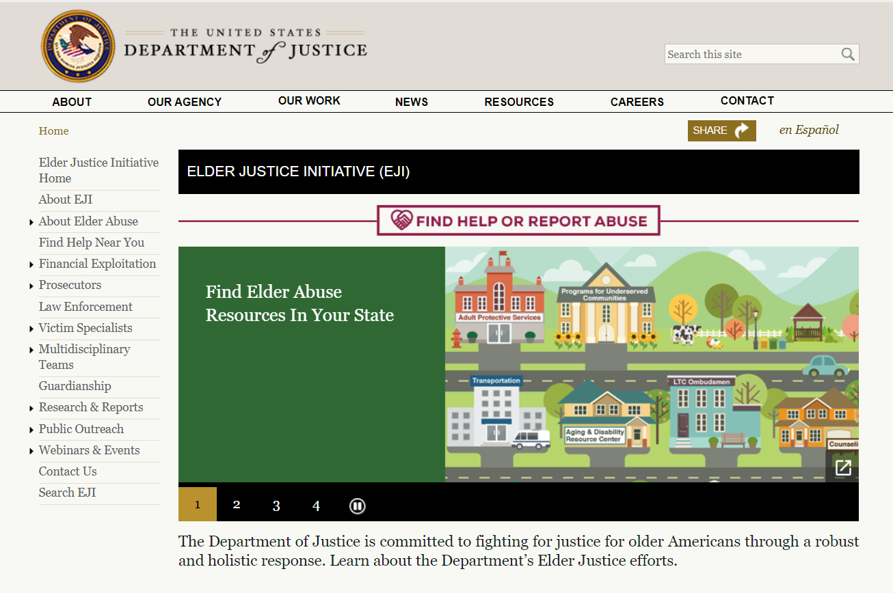
https://www.justice.gov/elderjustice

Slide 27
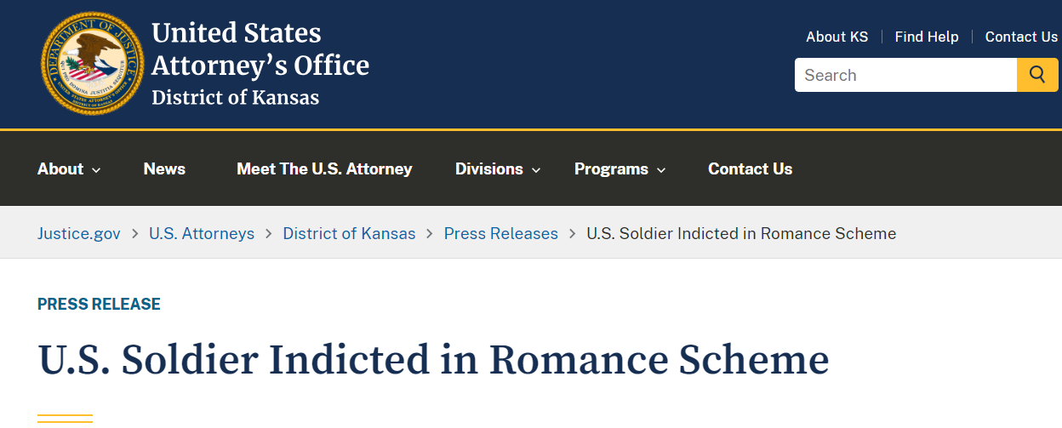

Slide 28
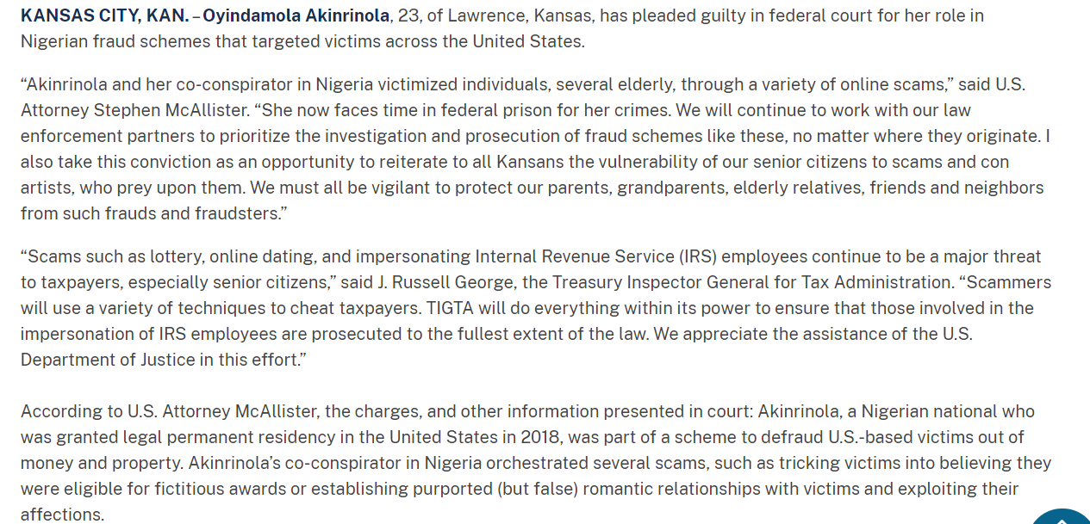

Slide 29
Civil Legal Aid Across Kansas
Matthew D. Keenan, Executive Director
KLS provides legal services to alleviate low income Kansans’ poverty burdens. It has 11 field offices and two mediation offices located across Kansas.
45 attorneys at KLS make it the 4th largest law firm in the state.
Our geographic territory includes all 105 Kansas counties.
In 2022, KLS attorneys and staff assisted 19,000 Kansans.
Almost 2,000 of those clients had some consumer related issue that required legal intervention.

Slide 30
Current trends: fear of being a victim of “porch pirates” lowers the guard to other thieves. Often involving text messaging.
Example: "your package is out for delivery." The senior was not expecting a package and thought someone was sending him a gift. But then follow up texts said the package delivery was delayed and the delivery guys needed money to fix the delivery truck. The fraud escalated to gift cards.

Slide 31
More creative uses of text messaging
Copycat bank fraud – sending a text message from a local Bank, where the victim does business, like Bank of America. The fake text notifies the recipient of a suspicious transaction from their bank account and asks them to reply "yes" or "no" to approve or reject a transaction.
Anyone who replies either way will get a call from a person posing as a representative from the fraud department of the bank and the scam continues.

Slide 32
Other types of fraud
We continue to see issues with car transactions, especially used cars. The used car shortage during COVID created opportunities for bad actors. Often they are buying a car for a grandchild or son or daughter who fell on hard times.
We had a new car dealer take advantage of a deaf couple, both of whom were 85, by signing them up for high interest credit cards and using the credit cards to finance a down payment.
Solar panels seem to be the old “window replacement” deals. One senior answered a robo-call and ended up signing a contract for ~$30k for solar panels. When she tried to cancel the contract before construction started and was told she would have to pay a cancellation fee.
Several of these cases involve electronic "signatures" on handheld devices, where the senior is not really sure they actually signed a contract by touching the screen... or not...

Slide 33
BBB Midwest Plains
Presenter: Josh Planos

Slide 34
Our Mission
To be the leader in advancing marketplace trust, we create a community
of trustworthy businesses and charities by:
Standard
Educate
Celebrate
Challenge
Setting standards for marketplace trust
Encouraging and supporting best practices, engaging with and educating consumers and businesses
Celebrating role models in the marketplace
Calling out and addressing substandard marketplace behavior
BBB Midwest Plains
Presenter: Josh Planos

Slide 35
Latest Data
Reports courtesy of BBB Scam Tracker
January 1, 2023 - August 31, 2023
Most-Reported Scams
Most-Reported Means of Contact
Most-Reported Payment Methods
Online Purchase (41.7%)
Employment (14.8%)
Phishing (11.8%)
Sweepstakes (2.5%)
Counterfeit Product (2.2%)
Email (26%)
Website (19.3%)
Social Media (16.7%)
Phone (15.6%)
Text Message (8.3%)
Credit Card (42.1%)
Bank Account Debit (20.3%)
Online Payment System (18.1%)
Prepaid Card (3.5%)
Check (2.7%)
BBB Midwest Plains
Presenter: Josh Planos

Slide 36
Thank
You
BBB Midwest Plains
Serving Kansas, Nebraska, South Dakota,
Southwest Iowa and Western Missouri
Contact us to get more info
jplanos@bbbinc.org
402-391-7612
@bbbmidwestplains
Presenter: Josh Planos

Slide 37
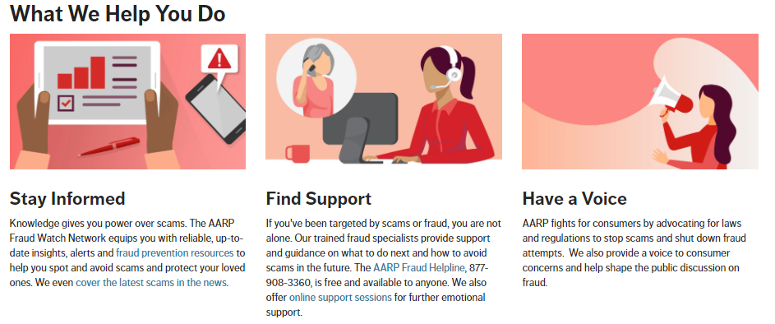
AARP Fraud Watch Network

Slide 38
AARP Fraud Watch Network Helpline
About the Helpline
Most Common
Scams Reported
Free to everyone
Report a scam
Get help figuring out if something is legitimate
Get help if you or a loved one has been targeted
Impostor Scams
Romance Scams
Prize/Sweepstakes Scams
Can You Do Me a Favor? Scams
The Helpline receives around 100k calls a year.
The average call time was over 20 minutes.

Slide 39
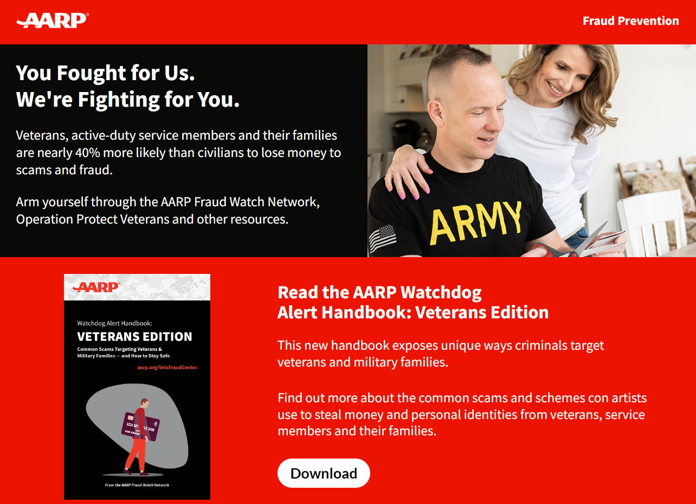
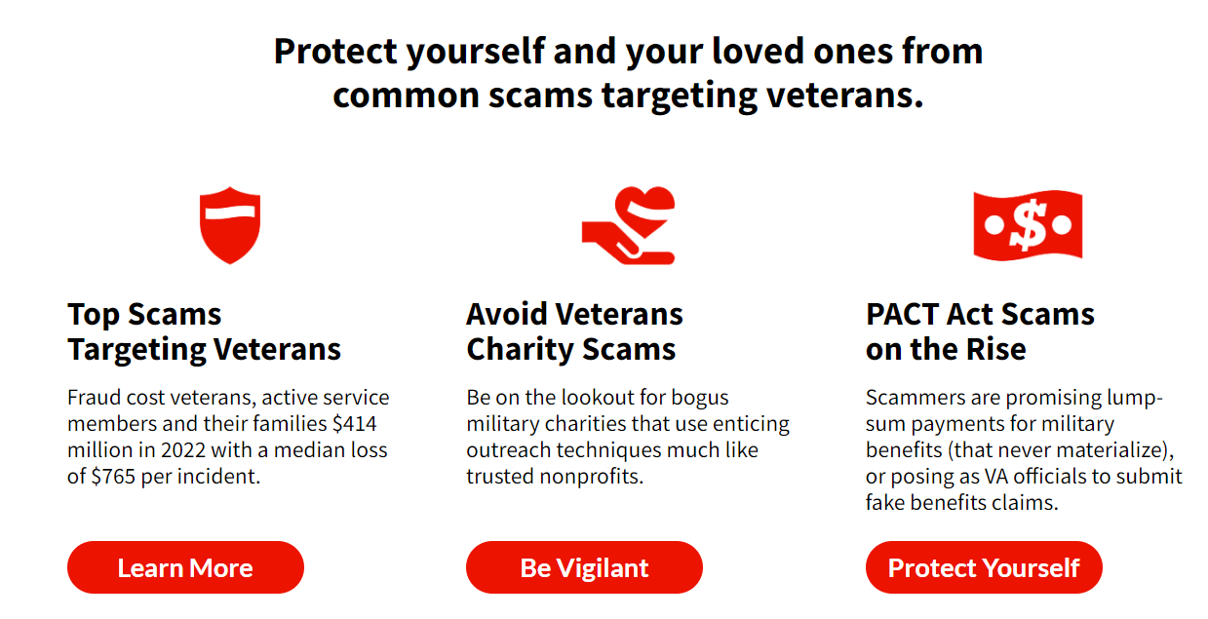
aarp.org/VetsFraudCenter

Slide 40
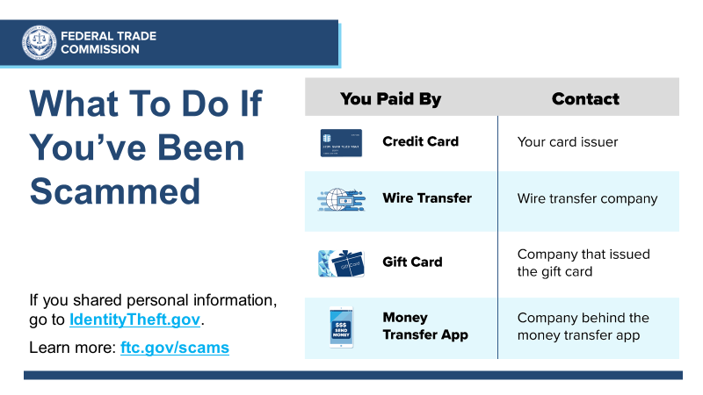

Slide 42
Keep up with the latest scams and share with your community
Sign up: ftc.gov/ConsumerAlerts
Order publications: ftc.gov/bulkorder

Slide 43
Use and Share Free FTC Resources
consumer.ftc.gov: hundreds of fraud articles
consumer.gov: consumer protection basics, plain and simple
ftc.gov/PassItOn: helping older adults protect others from fraud
YouTube.com/FTCVideos: view and share videos

Slide 44
Talk to Us
Help for Kansas’s Congressional delegation
Derick Rill, FTC’s Office of Congressional Relations drill@ftc.gov or 202-326-3007
Consumer Sentinel Network
ftc.gov/enforcement/consumer-sentinel-network
Nick Mastrocinque: nmastrocinque@ftc.gov

Slide 45
Q&A
Presenters:
Joannie Wei, FTC, Midwest Regional Office
Fran Oleen, Office of Kansas Attorney General Kris Kobach
Jon Fleenor, U.S. Attorney’s Office – District of Kansas
Matt Keenan, Kansas Legal Services
Josh Planos, Better Business Bureau of Kansas
Mary Tritsch, AARP Kansas
Cristina Miranda, FTC, Division of Consumer and Business Education
Andrew Rayo, FTC, Division of Consumer and Business Education

Slide 46
Thank you for joining us!
Slides available at: consumer.gov/StateWebinars
Please spread the word to fight fraud and
identity theft throughout Kansas!
Feedback about the webinar: everycommunity@ftc.gov

