Slide 1

Federal Trade Commission Webinar
Fighting Consumer Fraud &
Identity Theft in Montana
November 2, 2023

Slide 2
Welcome!
Presenters:
Jennifer Tourje, FTC, Northwest Regional Office
Brittany Divine, Montana Office of Consumer Protection
Renee Labrie-Shanks, Montana SMP
Dené Joubert, Better Business Bureau Great West + Pacific
Nancy Andersen, AARP Montana
Cristina Miranda, FTC, Division of Consumer and Business Education
Gema de las Heras, FTC, Division of Consumer and Business Education

Slide 3
Overview
The Montana landscape
The latest scams
Identity theft
Working together to fight fraud and identity theft

Slide 4
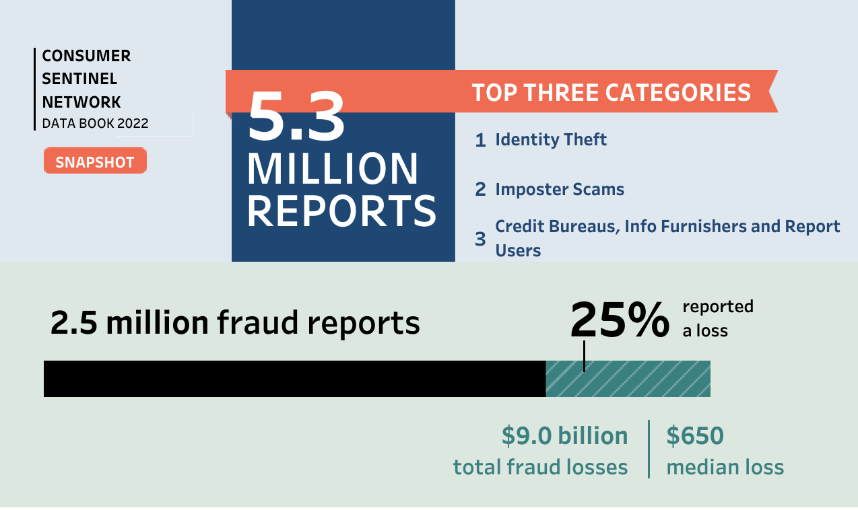
National Data

Slide 5
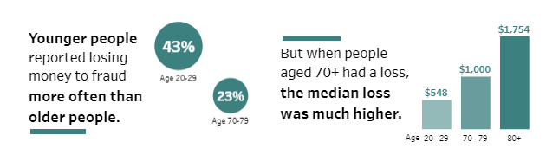
National Data

Slide 6
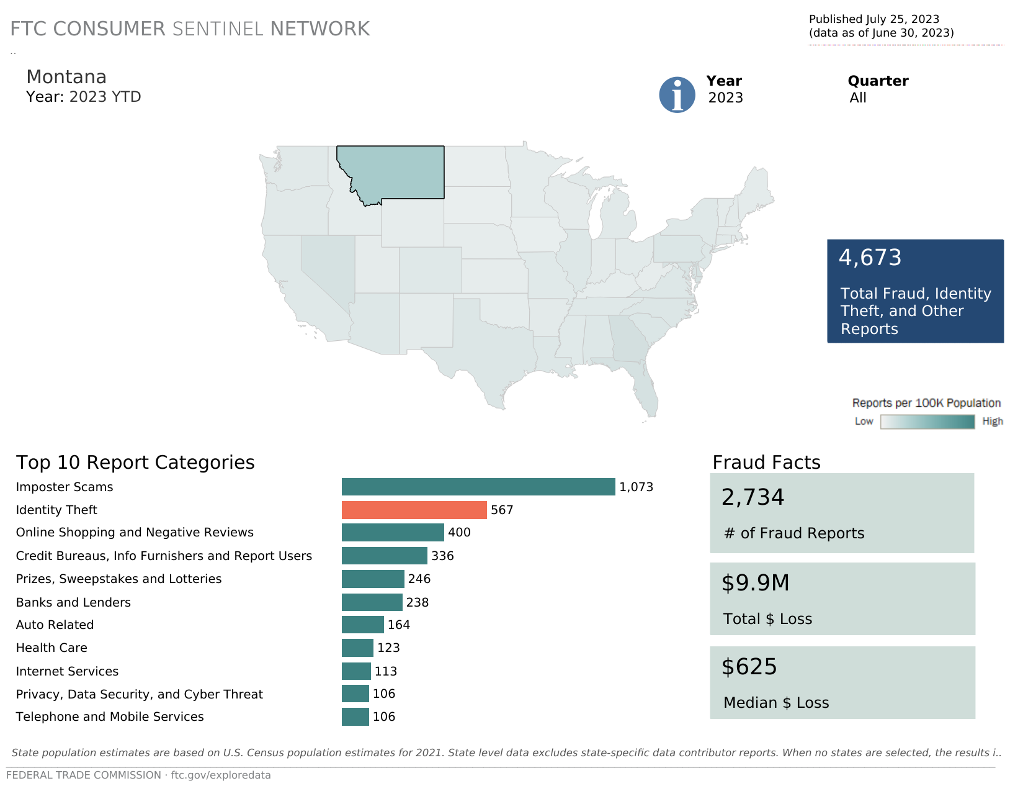

Slide 7
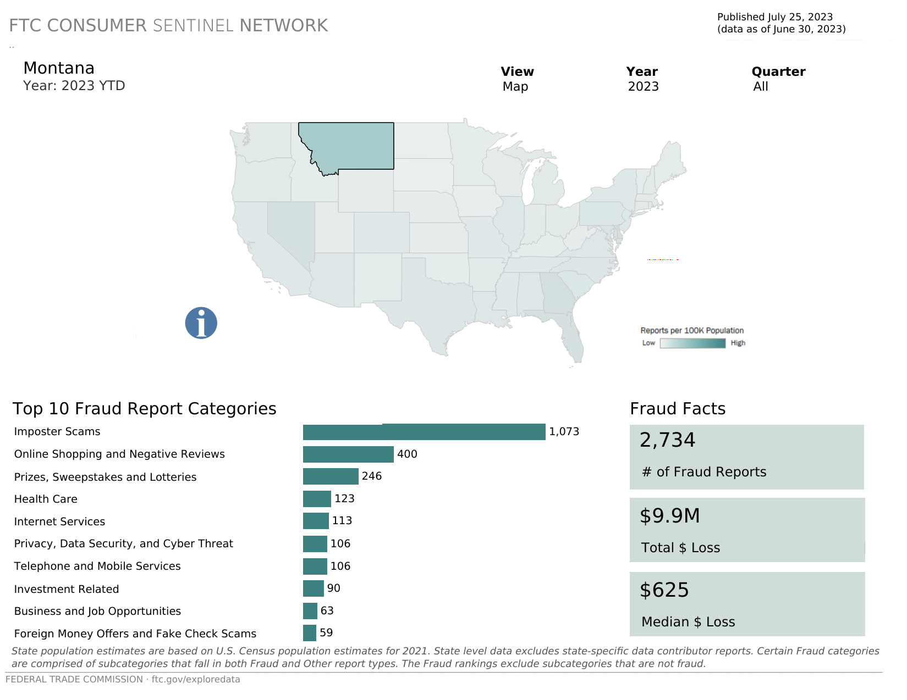

Slide 8
THE LATEST SCAMS

Slide 9
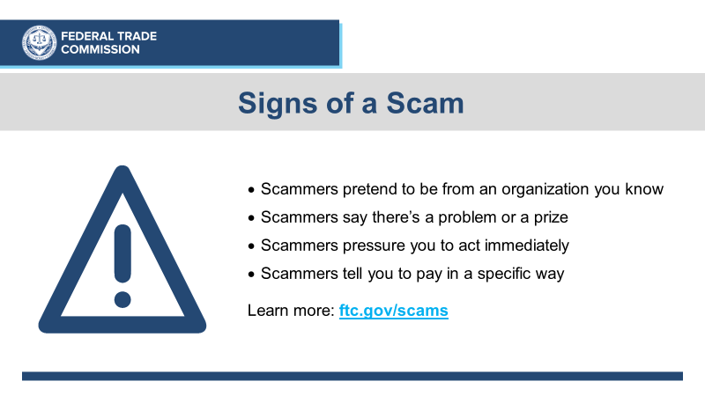

Slide 10
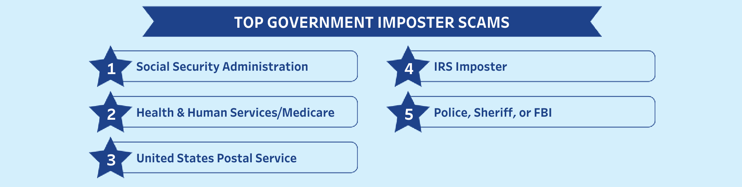

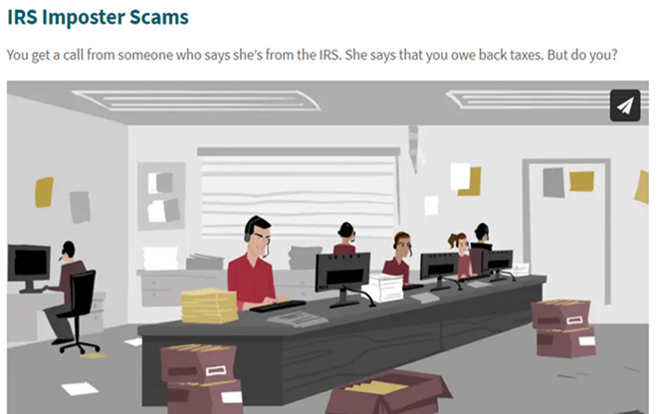
Government Impersonator Scams

Slide 11
Government Impersonator Scams
Government agencies don’t call people with threats or promises of money
Do not trust caller ID
Check with the real agency
Only scammers demand payment by gift card, wire transfer, cryptocurrency, or payment app
ftc.gov/imposters

Slide 12
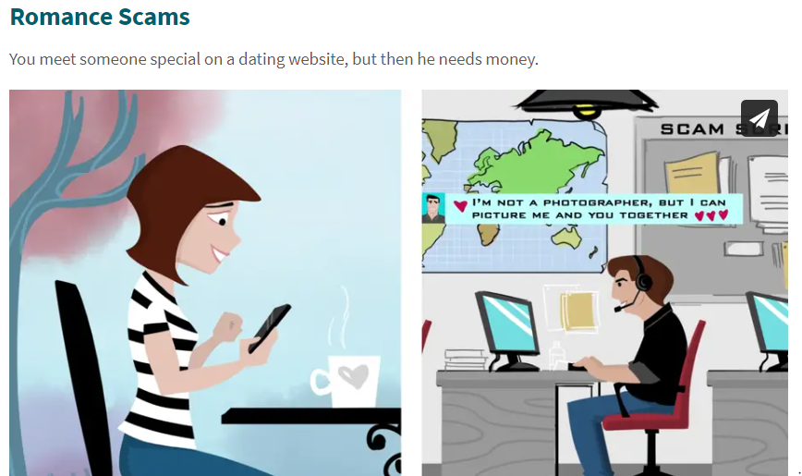
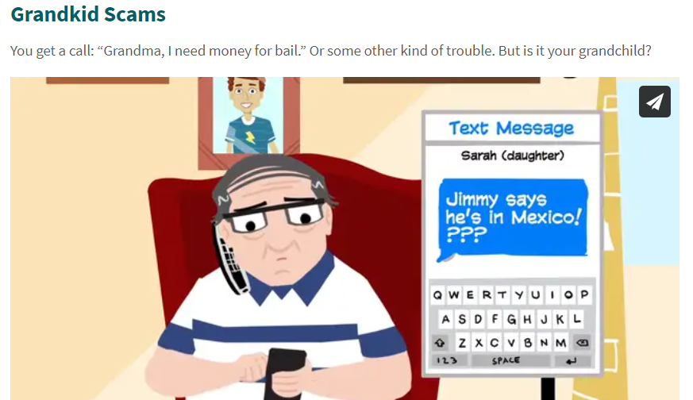
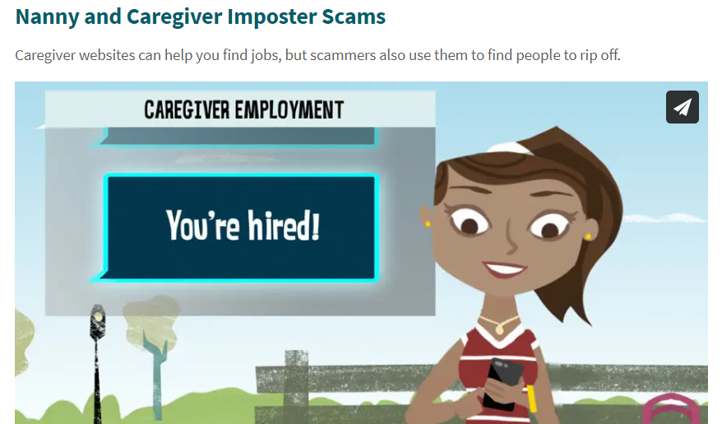
ftc.gov/imposters

Slide 13
Business Impersonator Scams
If you got an unexpected call, text, message:
Don’t call a phone number they gave you.
Don’t click on any links.
Don’t give remote computer access.
REMEMBER: Only scammers demand payment by gift card, wire transfer, cryptocurrency or a payment app.

Slide 14


Someone uses your personal information to:
  Open accounts
  File taxes
  Buy things

Slide 15



Examples of Misuse
Impact
Open Credit Cards
Open Utility Accounts
Apply for a Tax Refund
Get a Loan
Apply for Employment
Get Medical Care
Denial of credit/loans
Denial of public benefits
Denial of medical care
Denial/loss of employment
Harassment by debt collectors
Legal issues/arrest
Stress/anxiety
Recovery time/expense

Slide 16
Reduce the Risk
Review mail, especially financial statements
Check credit report every year:
  Free report from AnnualCreditReport.com
Protect Social Security and Medicare numbers
Store documents securely and shred before discarding
File taxes early

Slide 17
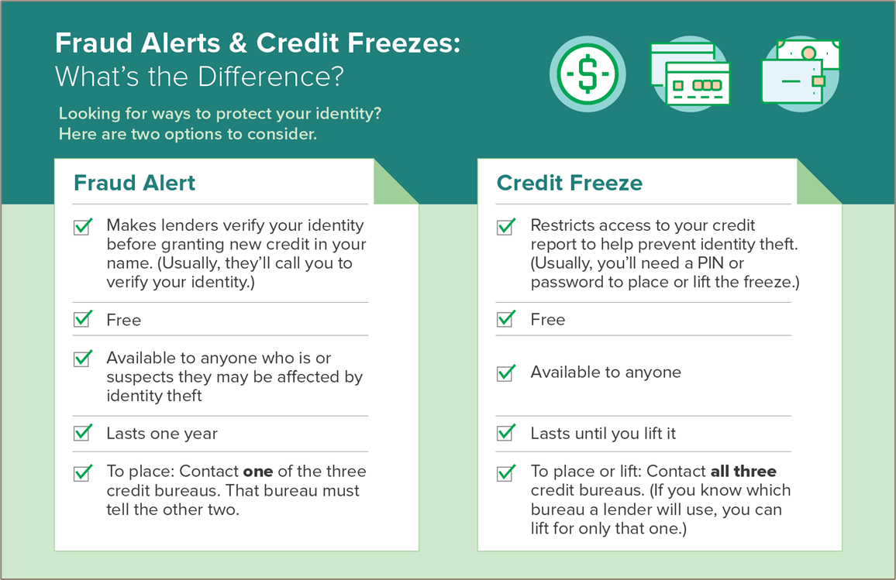

Slide 18
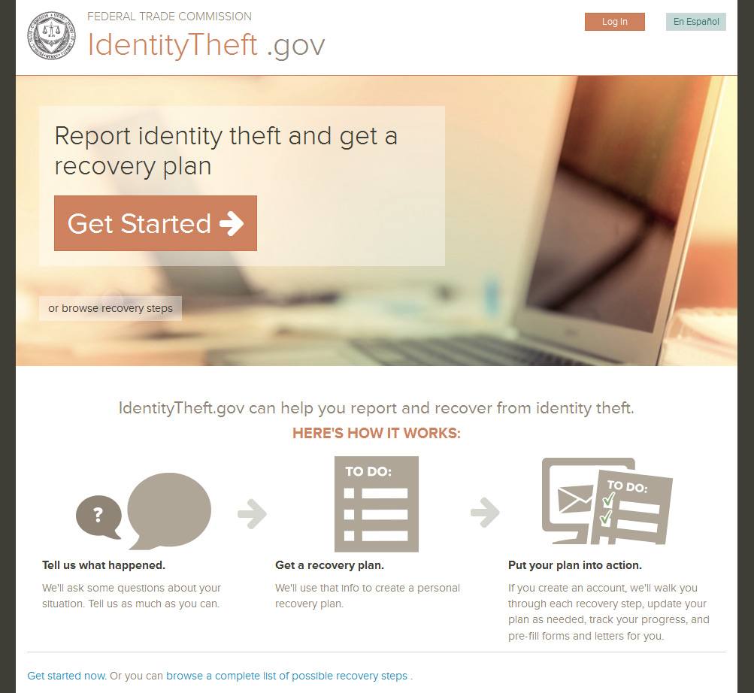

Slide 19
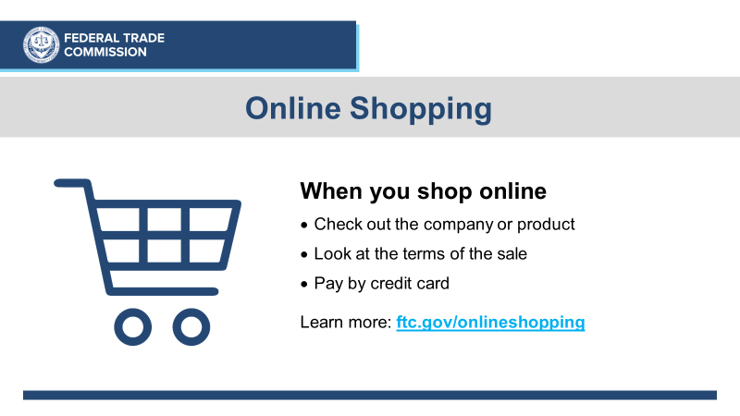

Slide 20
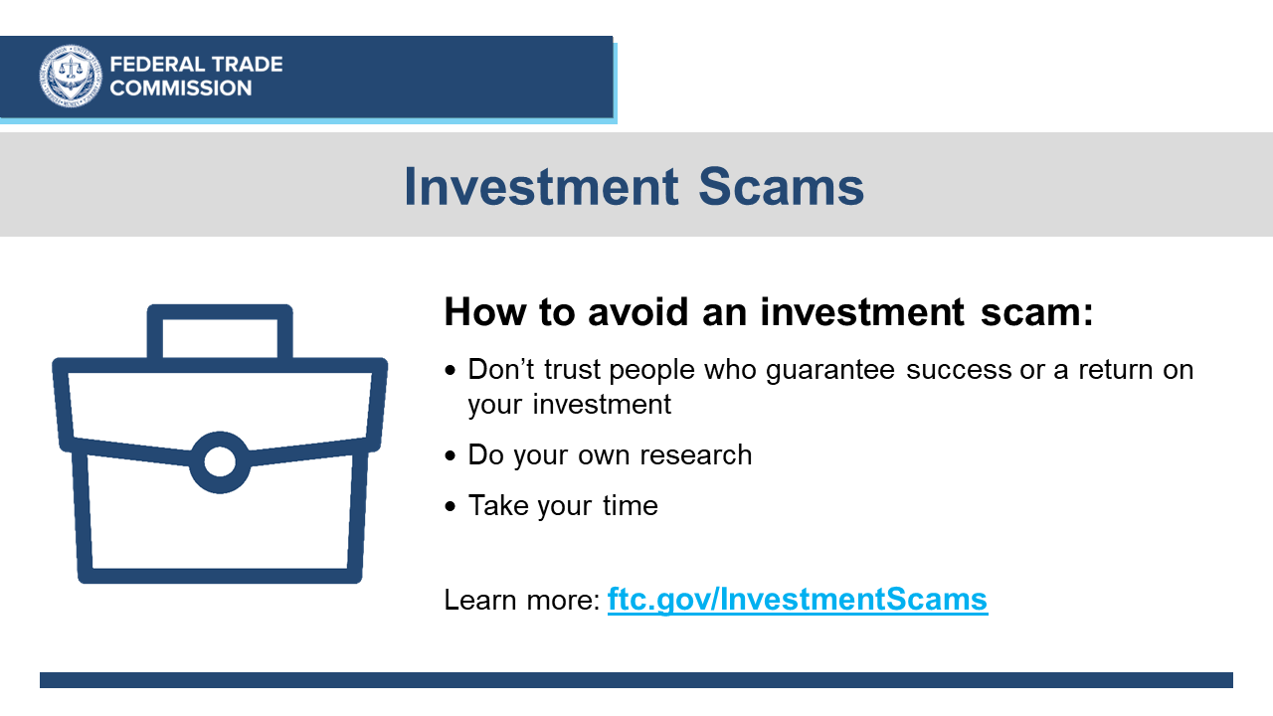

Slide 21

Montana Department of Justice
Office of Consumer Protection
MONTANA OFFICE OF CONSUMER PROTECTION
302 N. Roberts
Helena 59601
406.444.4500
dojmt.gov/consumer

Slide 22
OCP Responsibilities
Educate the public on current scams and how to spot them and avoid them
Provide information to consumers about the Consumer Protection Act
Investigate false, misleading, or deceptive trade practices
Initiate enforcement actions in Montana
MONTANA OFFICE OF CONSUMER PROTECTION

Slide 23
OCP Programs
Consumer Complaints – Informal Mediation
End of Life Registry
Consumer & Scam Alerts
Consumer Education/Outreach
Identity Theft Passport
Data Breaches
Telemarketing Registration
Debt Management & Debt Settlement Licensing
Unauthorized Practice of Law
Tow Truck Dispute Resolution
MONTANA OFFICE OF CONSUMER PROTECTION

Slide 24
Office of Consumer Protection Contacts
OCP Main: (406)444-4500
OCP Toll Free: (800)481-6896
OCP Email: contactocp@mt.gov
OCP Website: www.dojmt.gov/consumer
OCP Montana Scam Alerts: www.dojmt.gov/consumer/scam-alerts/
302 N. Roberts Street
Helena MT 59601
MONTANA OFFICE OF CONSUMER PROTECTION

Slide 25



SMP is Senior Medicare Patrol.
MT SMP is a federally designated entity for reporting cases of Medicare fraud, errors, and abuse.
MT SMP’s mission is to empower and assist Medicare beneficiaries, their families, and caregivers to prevent, detect, and report health care fraud, abuse, and errors through outreach, counseling, and education.
This project was supported by grant #90MPPG0052 from the U.S. Administration for Community Living, Department of Health and Human Services, Washington D.C., 20201. Points of view or opinions do not necessarily represent official ACL policy.
Montana SMP is a program coordinated by Missoula Aging Services and partnered with local Area Agencies on Aging.

Slide 26
Who is Affected?
Taxpayers
Medicare trust fund
Higher premiums
Less money available for needed benefits
Quality of treatment
Medicare loses at least
$65 billion
each year due to fraud, errors, and abuse.
Montana SMP is a program coordinated by Missoula Aging Services and partnered with local Area Agencies on Aging.

Slide 27

How SMP
Can Support Your Organization
SMP Conducts Outreach and Education
Providing educational presentations to beneficiaries, family members, caregivers, and health providers on how to prevent, detect, and report Medicare fraud, abuse, and errors as well as other types of fraud.
Provide educational presentations to older adults, caregivers, service providers, and the general public on how to prevent fraud and scams.

Slide 28
How SMP
Can Support Your Organization
SMP Research Beneficiary Complaints
We help determine if the suspicious activity is fraud, error, or abuse.
Providing one-on-one assistance to help navigate the complexities of Medicare and to provide resources and information.
Providing help to those who have been victimized, and providing ongoing support to prevent further victimization
We make referrals to the appropriate state/federal agencies for further investigation.

Slide 29

RENEE LABRIE-SHANKS
Statewide SMP Program Director
rlabrie@missoulaagingservices.org
T 406.728.0581 C 406.880.7693 F 406.728.7687
337 Stephens Ave. Missoula, MT 59801
MISSOULAAGINGSERVICES.ORG
Thank You!
We promote the independence, dignity and health
of older adults and those who care for them.
This project was supported by grant #90MPPG0052 from the U.S. Administration for Community Living, Department of Health and Human Services, Washington D.C., 20201. Points of view or opinions do not necessarily represent official ACL policy.
Montana SMP is a program coordinated by Missoula Aging Services and partnered with local Area Agencies on Aging.
Notes:
.

Slide 30
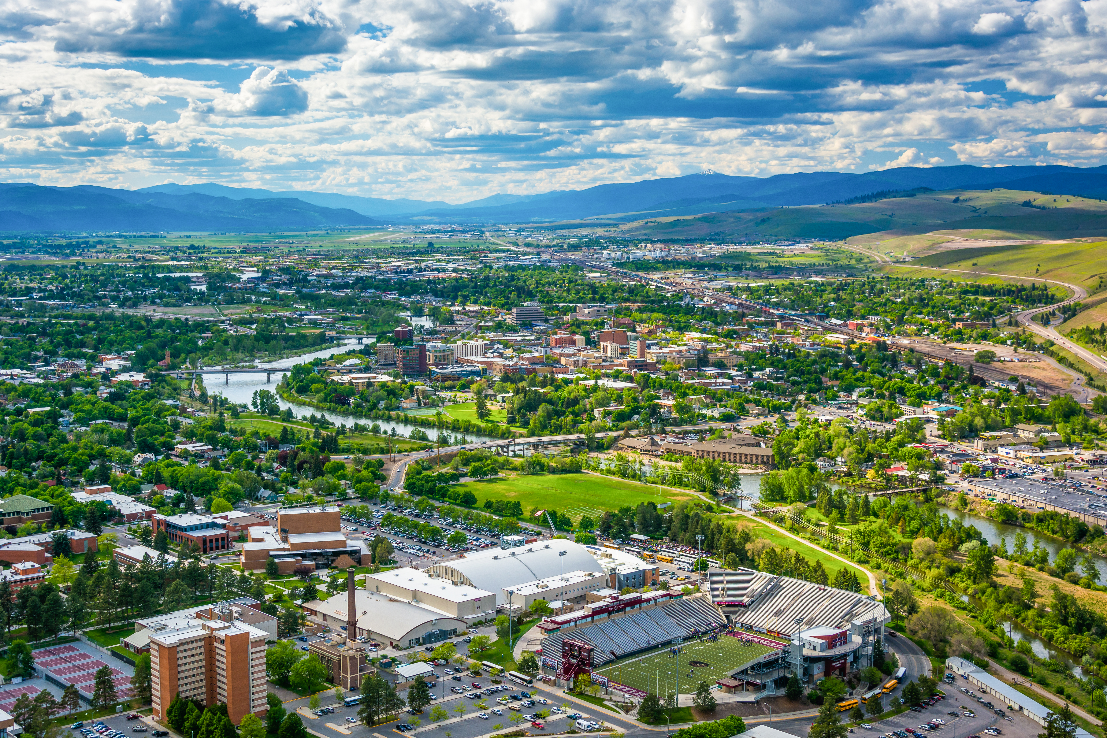

BETTER BUSINESS BUREAU
SERVING MONTANA

Slide 31

Our Mission:
To be the leader in building better businesses and advancing marketplace trust.

Slide 32
BBB helps people find businesses they can trust.

Slide 33
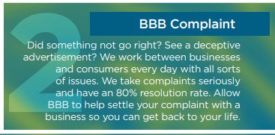
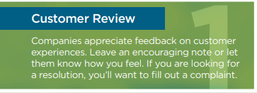
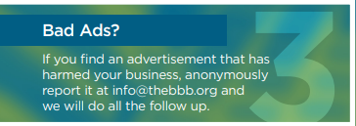
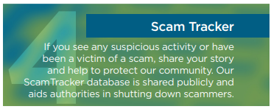
YOUR EXPERIENCE MATTERS
Connect with us. bbb.org/all/consumer-resources

Slide 34

TOPS SCAMS IN MONTANA
Scam Tracker Data
October 2022 – October 2023
193 Reports
$82,973.74 loss
$225,971.95 attempted loss
Scam Types
Online Purchase
  Websites and Ads selling Puppies & Kittens that don’t exist
Phishing
Employment
Dené Joubert
Investigations Manager
Dene.joubert@thebbb.org
www.bbb.org

Slide 35

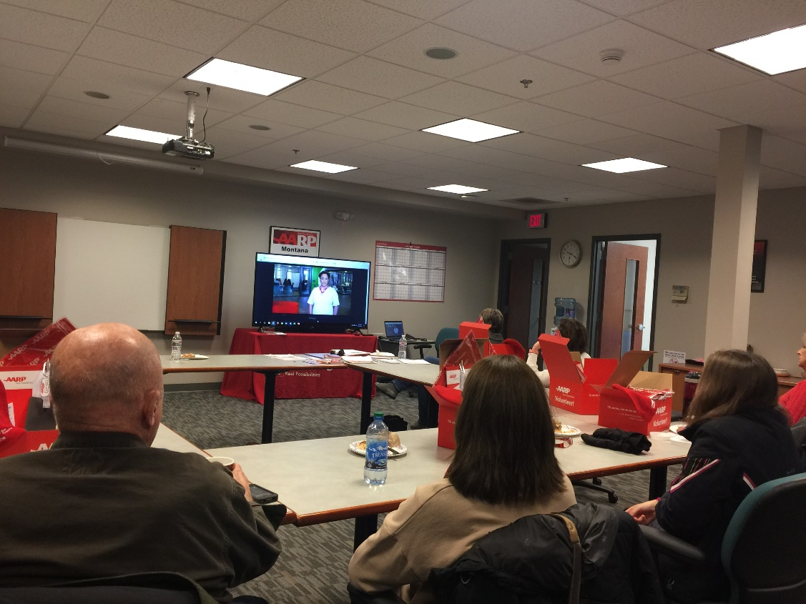
Fraud Prevention Presentations
In-Person and Virtual
Your Identity – Staying Connected & Protected
Imposter Fraud Scams
Online Relationship Scams

Slide 36
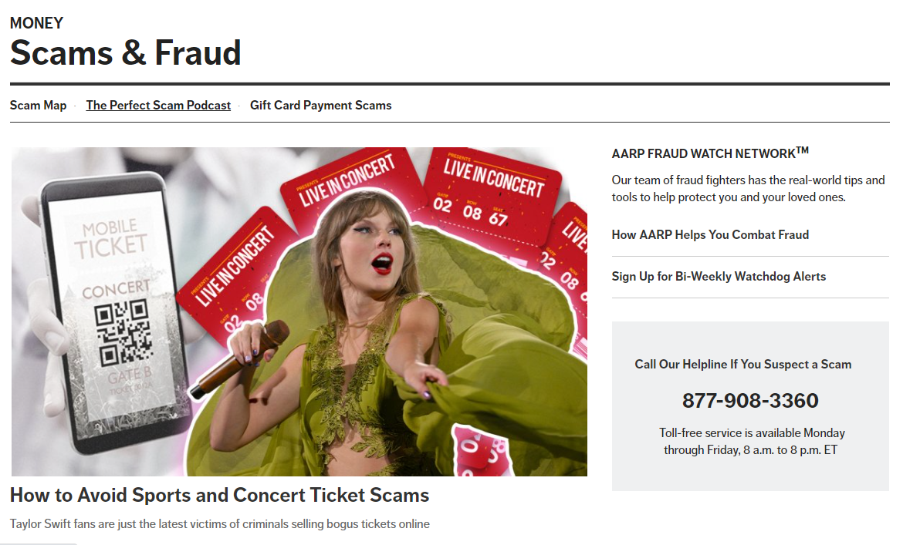
Fraud Watch Network Online Resources

Slide 37
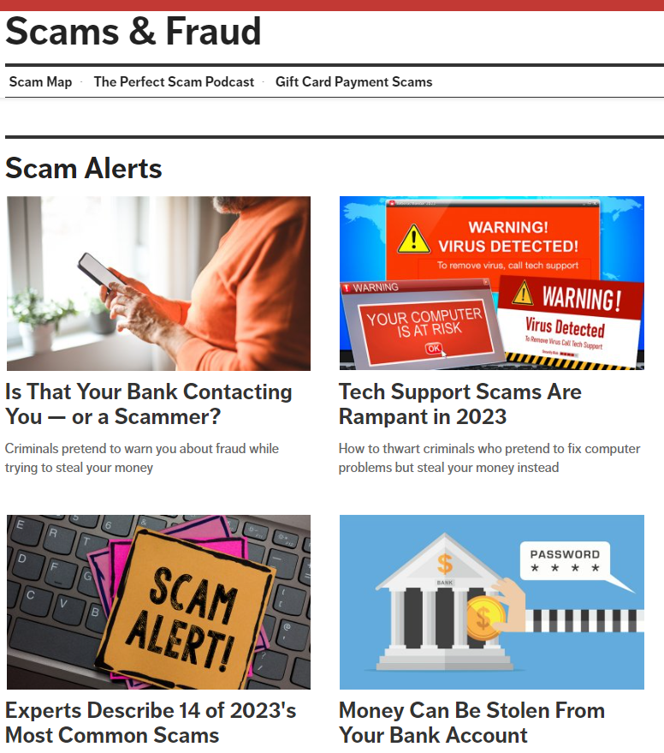
Watchdog Alerts to
Your Inbox

Slide 38


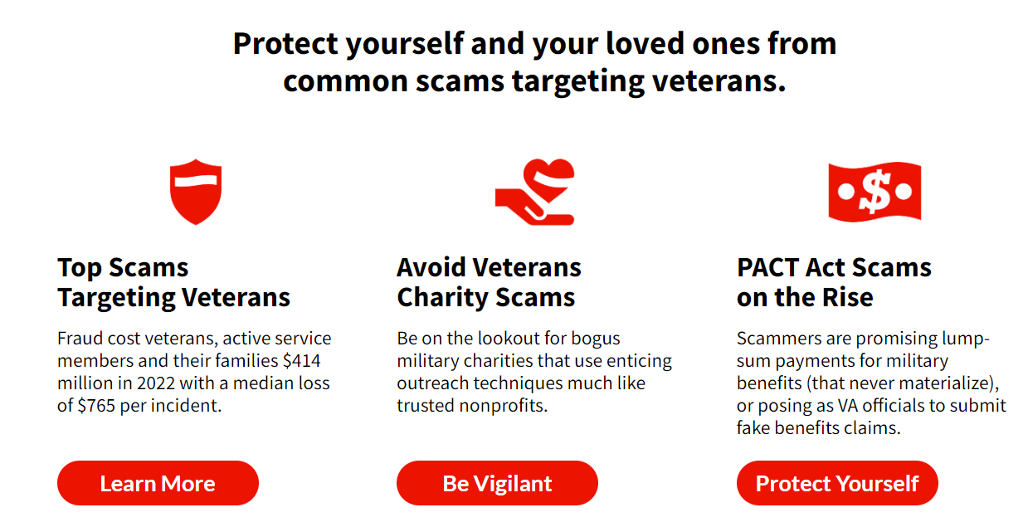
Online Resources
for Veterans
aarp.org/VetsFraudCenter

Slide 39


Free Publications for Individuals or Groups
Free Publications
Contact Nancy Andersen, AARP Montana Outreach Director
Phone: 406-457-4703; Email: nandersen@aarp.org ; AARP MT Webpage: aarp.org/mt

Slide 40
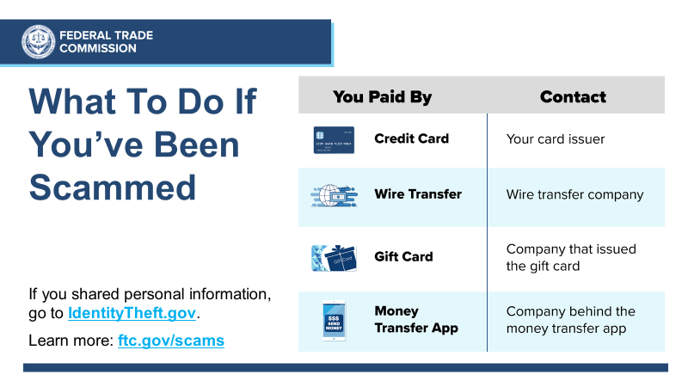

Slide 41
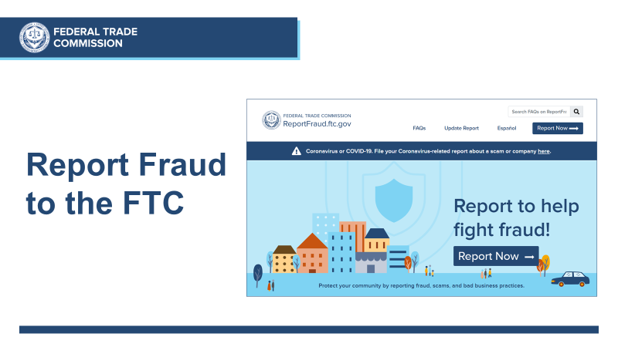

Slide 42
Call Center Enhancements
Take fraud reports in multiple languages
  Call (877) 382-4357, press 3
Take identity theft reports in multiple languages
  Call (877) 438-4338, press 3
Languages: Mandarin, Tagalog, Vietnamese, French, Arabic, Korean, Russian, Portuguese, Polish, and more

Slide 43
Keep up with the latest scams and share with your community
Sign up: ftc.gov/ConsumerAlerts
Order publications: ftc.gov/bulkorder

Slide 44
Use and Share Free FTC Resources
consumer.ftc.gov: hundreds of fraud articles
consumer.gov: consumer protection basics, plain and simple
ftc.gov/PassItOn: helping older adults protect others from fraud
YouTube.com/FTCVideos: view and share videos

Slide 45

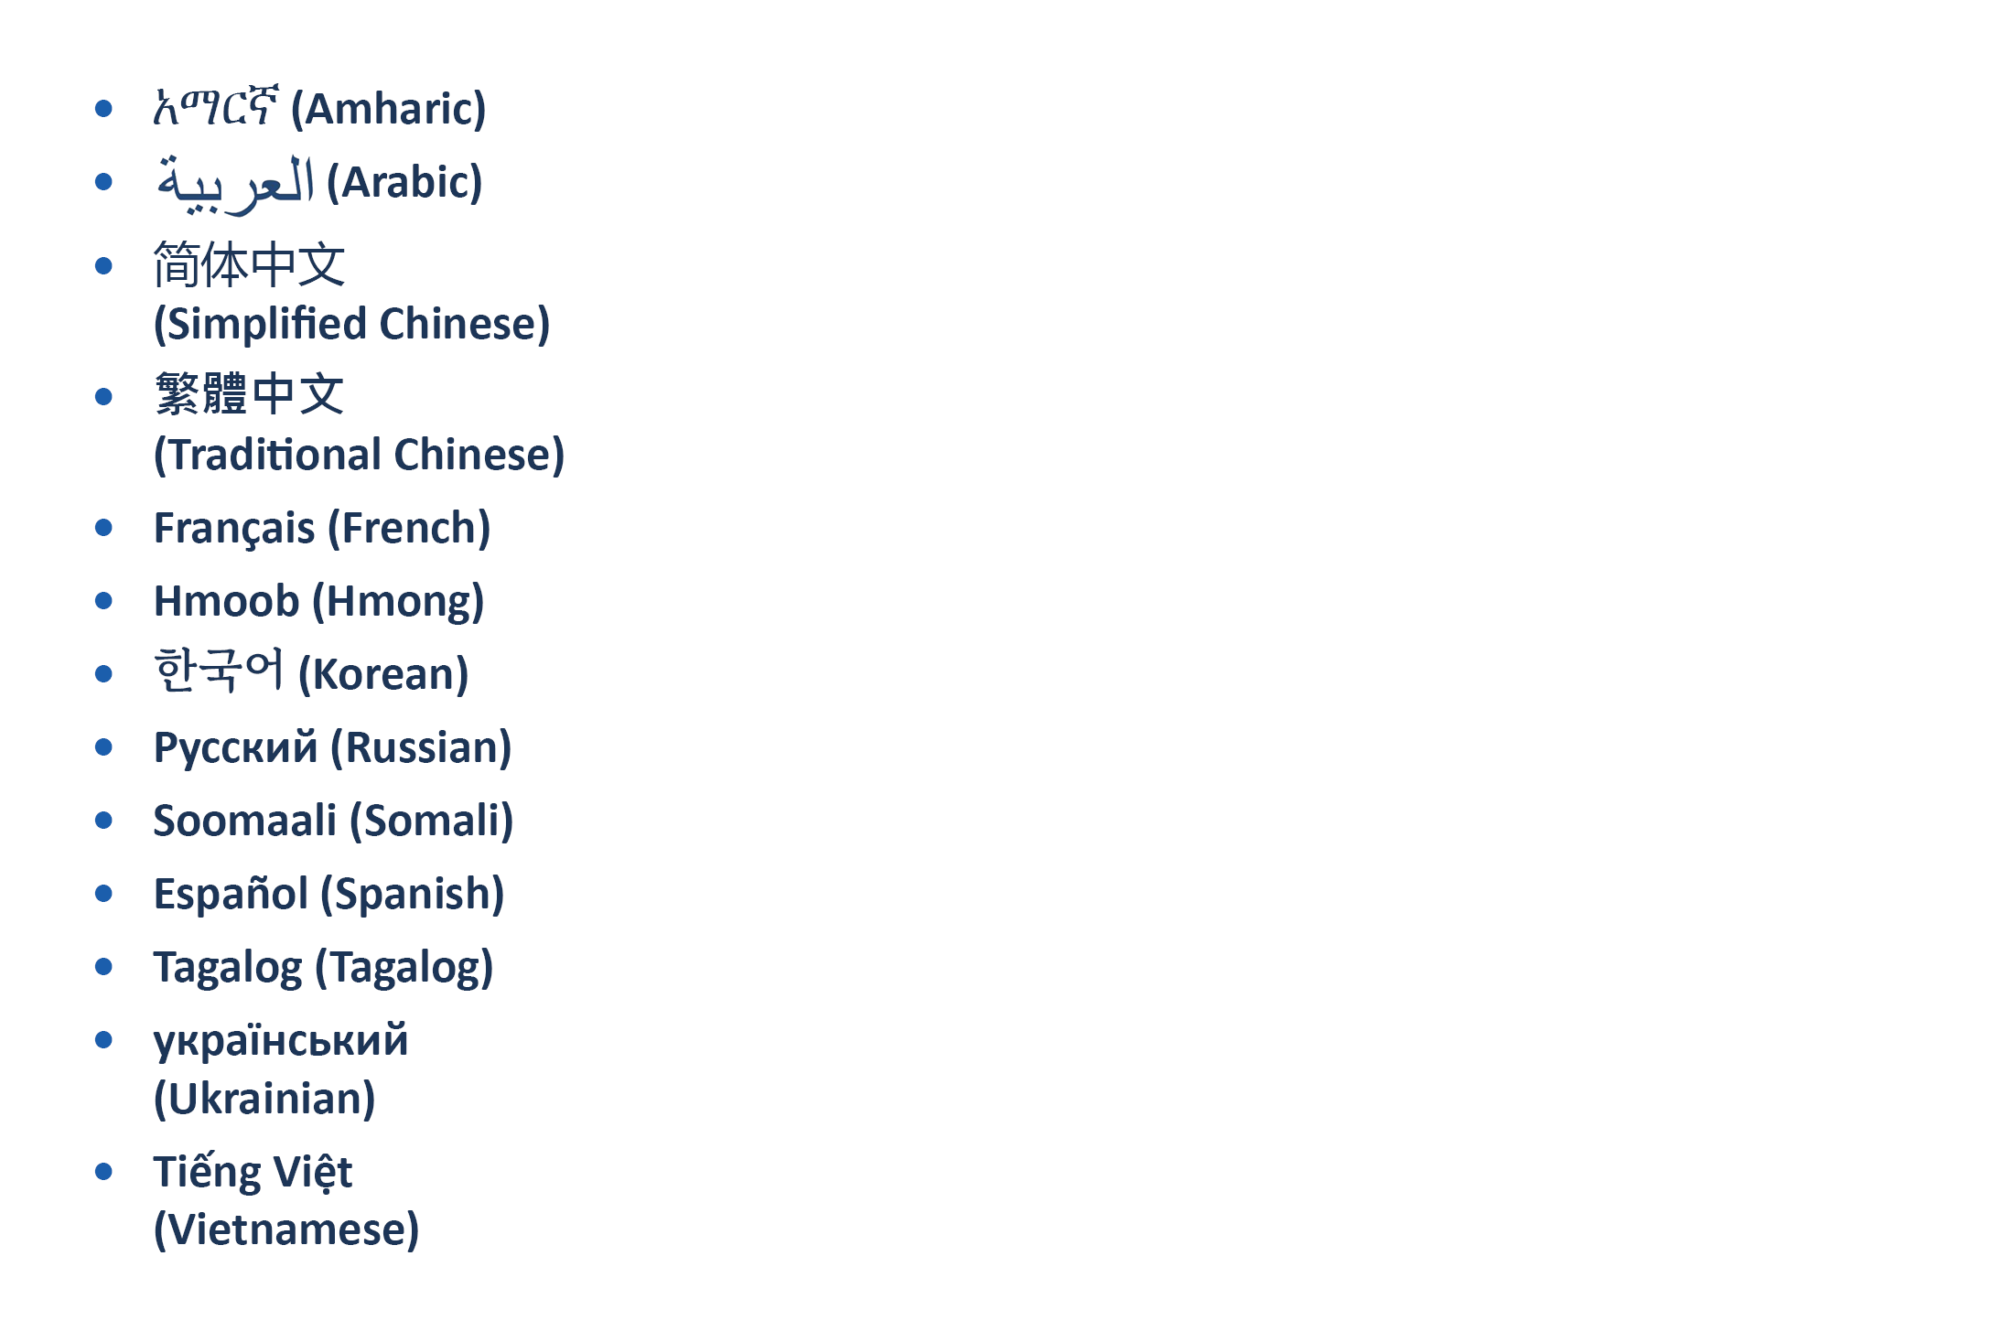
New Consumer and Business Resources
ftc.gov/languages

Slide 46
Talk to Us
Help for Montana’s Congressional delegation
  Derick Rill, FTC’s Office of Congressional Relations
  drill@ftc.gov or 202-326-3007
Consumer Sentinel Network
ftc.gov/enforcement/consumer-sentinel-network
  Nick Mastrocinque: nmastrocinque@ftc.gov
Criminal Liaison Unit (CLU) for coordinating criminal referrals:
  Greg Madden: gmadden@ftc.gov or 202-326-2426

Slide 47

Q&A
Presenters:
Jennifer Tourje, FTC, Northwest Regional Office
Brittany Divine, Montana Office of Consumer Protection
Renee Labrie-Shanks, Montana SMP
Dené Joubert, Better Business Bureau Great West + Pacific
Nancy Andersen, AARP Montana
Cristina Miranda, FTC, Division of Consumer and Business Education
Gema de las Heras, FTC, Division of Consumer and Business Education

Slide 48

Thank you for joining us!
Slides available at: consumer.gov/StateWebinars
  Please spread the word to fight fraud and
  identity theft throughout Montana!

